Slide 1
Internship Project: Question-Answering(QA) system
He Cheng Hui

Slide 2
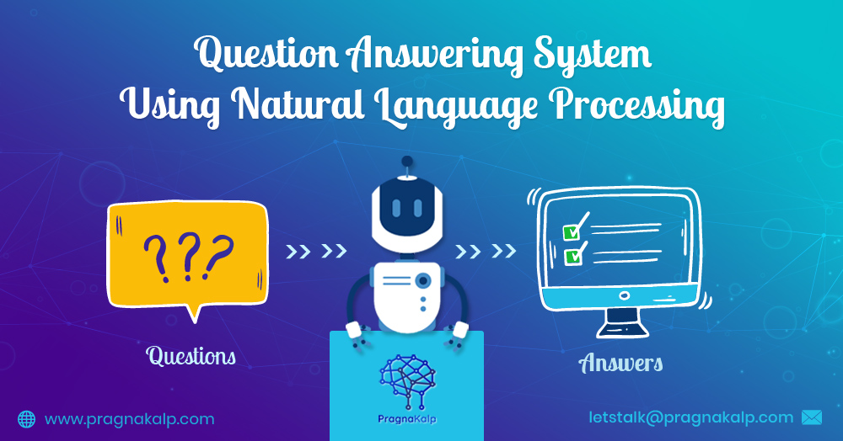
What is a QA system?
Natural Language Processing (NLP): Field of AI that gives machines the ability to read, understand and even reply in human languages
Picture source: https://www.pragnakalp.com

Slide 3
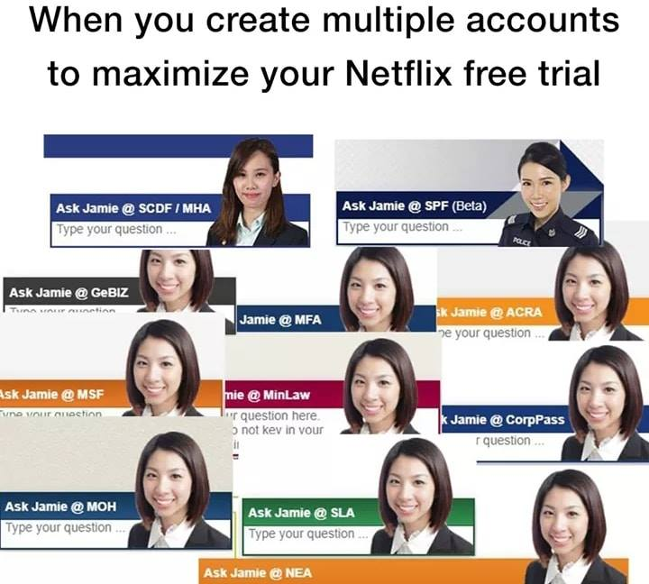

Examples of QA system

Slide 4


overview of QA system

Slide 5
overview of QA system
Retriever
Database / Knowledge base
(a collection of documents)

Slide 6
overview of QA system
Retriever
Reader
Database / Knowledge base
(a collection of documents)

Slide 7

Introducing Haystack
Haystack is an open-source framework for building search systems that work intelligently over large document collections. Recent advances in NLP have enabled the application of question answering, retrieval and summarization to real world settings and Haystack is designed to be the bridge between research and industry.
Picture source: https://github.com/deepset-ai/haystack

Slide 8
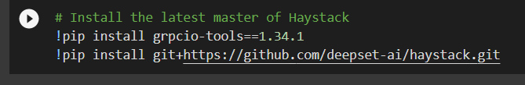
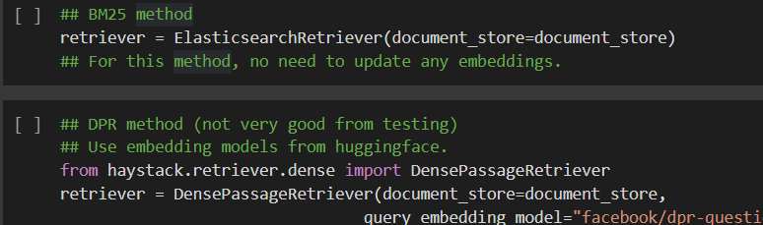
Demo
https://colab.research.google.com/drive/1usrI9eyKYbE-pEwMVstulL35RjHDbFXY?usp=sharing
Only run either one

Slide 9

Testing & Results: Pre-haystack
Picture source: https://huggingface.co/

Slide 10






Testing & Results: Pre-haystack

Slide 11


Testing & Results: Pre-haystack
Avg time per Q (s)
26.9
-
-
20.9
22.1
-
Q1 | Q2 | Q3 | Q4 | Q5 | Q6 | Q7 | Q8 | Q9 | Q10
OOM | OOM | OOM | OOM | OOM | OOM | OOM | OOM | OOM | OOM
OOM | OOM | OOM | OOM | OOM | OOM | OOM | OOM | OOM | OOM
OOM | OOM | OOM | OOM | OOM | OOM | OOM | OOM | OOM | OOM
Roberta
Bert-sqaud2
Bert-finetuned squad
Distilbert-uncased
Distilbert-cased
Albert
- Refers to this model giving a partially correct answer to the question
OOM - Refers to this model giving an Out-Of-Memory error
NOTE: All models were tested on 10 questions set by me and run on GPU. 36 News articles from the HTX News section are used as the database.

Slide 12
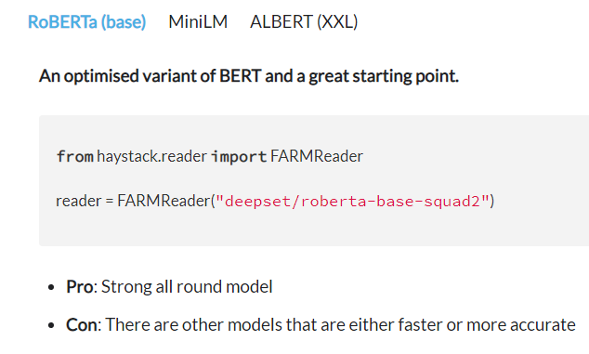
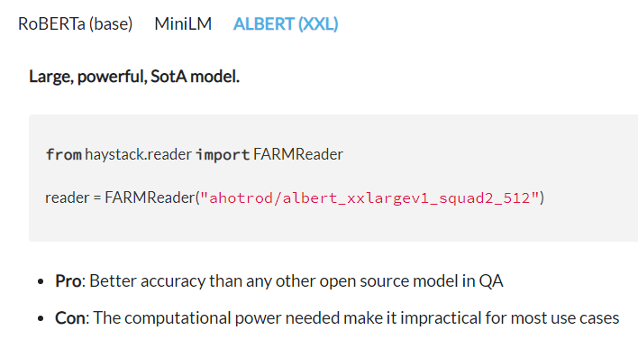


Testing & Results: Pre-haystack

Slide 13
Testing & Results: haystack
Haystack Framework
Retriever
Reader
Model: Roberta-base-squad2
Database / Knowledge base
(a collection of documents)

Slide 14
Testing & Results: haystack-Document store
Document store
SQL
Elasticsearch
FAISS
Weaviate
Milvus
In Memory

Slide 15

Testing & Results: haystack-Document store
Document store
Elasticsearch
Near real-time search
Good accuracy with sparse retrievers that look at keywords
Basic support for dense retrievers that uses vector embeddings
Used by many tech companies like Grab, GitHub & Facebook

Slide 16

Testing & Results: haystack-Document store
Document store
Elasticsearch
Faiss
Near real-time search
Good accuracy with sparse retrievers that look at keywords
Basic support for dense retrievers that uses vector embeddings
Used by many tech companies like Grab, GitHub & Facebook
Fast and accurate dense retriever that uses vector embeddings

Slide 17
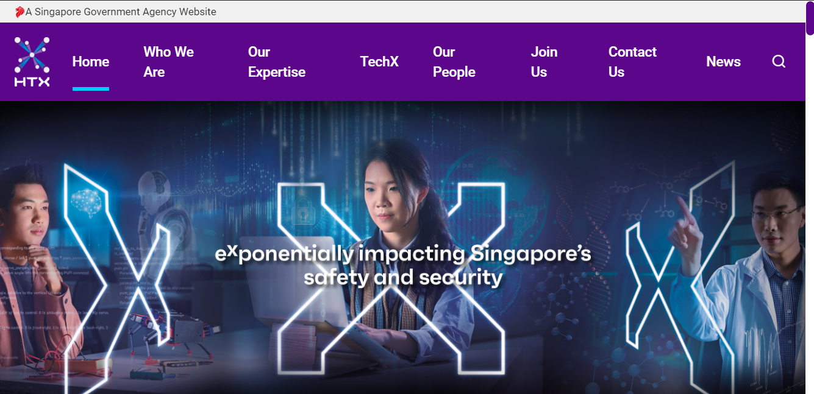
Testing & Results: haystack-pre-processing
Picture source: https://www.htx.gov.sg/

Slide 18
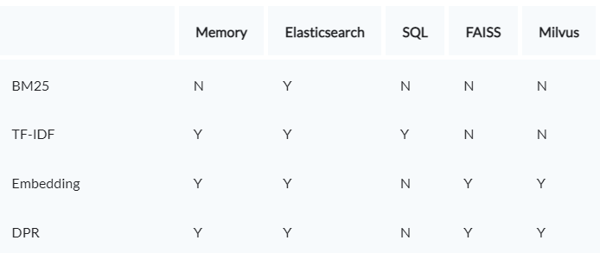
Testing & Results: haystack-Retriever
Picture source: https://haystack.deepset.ai/docs/latest/retrievermd

Slide 19
Testing & Results: haystack-Retriever
Picture source: https://haystack.deepset.ai/docs/latest/retrievermd

Slide 20
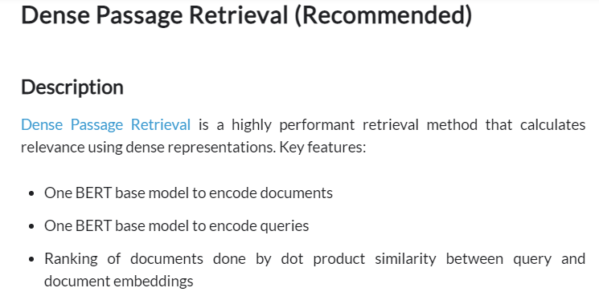
Testing & Results: haystack-Retriever
Picture source: https://haystack.deepset.ai/docs/latest/retrievermd

Slide 21
Testing & Results: haystack-Reader
Avg time per Q (s)
1.0
1.7
Q1 | Q2 | Q3 | Q4 | Q5 | Q6 | Q7 | Q8 | Q9 | Q10
TransformersReader
FarmReader
NOTE: All models were tested on the same 10 questions set by me and run on GPU. 46 News articles from the HTX Website are used as the database.

Slide 22
Testing & Results: haystack-Ranker
Haystack Framework
Retriever: BM25
Reader: TransformersReader
Model: Roberta-base-squad2
General QA pipeline
Document Store: Elasticsearch

Slide 23
Testing & Results: haystack-Ranker
Haystack Framework
Retriever: BM25
Reader: TransformersReader
Model: Roberta-base-squad2
Customised QA pipeline with added Ranker component
Ranker
Document Store: Elasticsearch

Slide 24
Testing & Results: haystack-Ranker
Haystack Framework
Retriever: BM25
Reader: TransformersReader
Model: Roberta-base-squad2
BM25 (sparse retriever) does not consider semantics of the documents and the query but only their keywords.
Ranker
The Ranker can re-rank the results of the retriever step by taking semantics into account.
Document Store: Elasticsearch

Slide 25
Future works
Further Testing
Long Form Question Answering (LFQA)

Slide 26
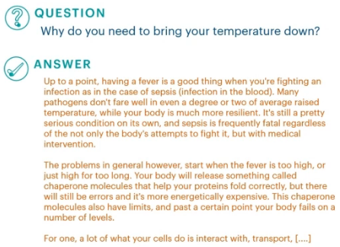

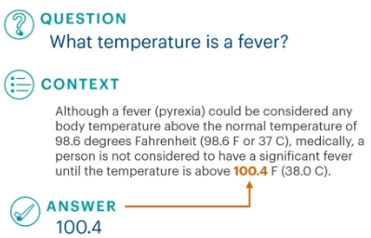
Future works
Further Testing
Long Form Question Answering (LFQA)
Pictures source: https://vimeo.com/384783066

Slide 27
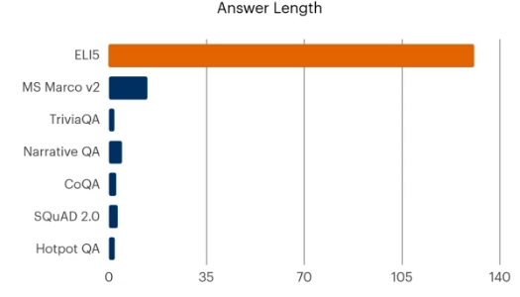
Future works
Further Testing
Long Form Question Answering (LFQA)
Explain Like I’m Five LFQA dataset
(Some) Current QA datasets
Picture source: https://vimeo.com/384783066

Slide 28
Thank You

